Slide 1

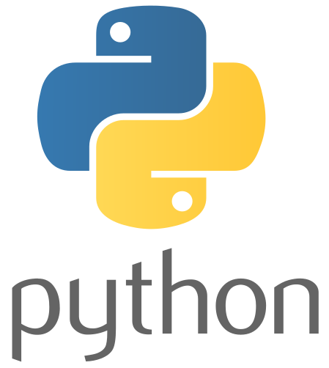
PyLadies Tunis
Meetup #1
Meetup #1

Slide 2

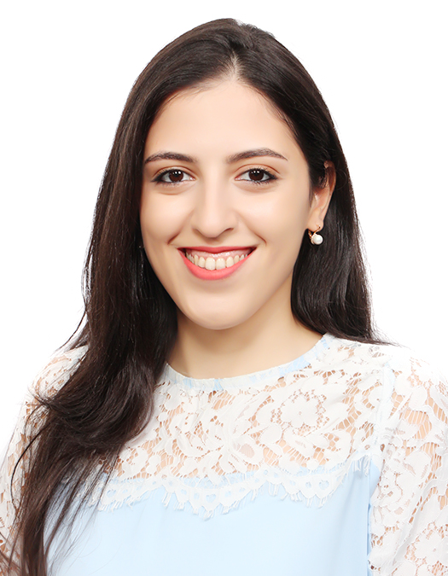





About Us
A network of Python practitioners in Tunis, Tunisia
We are women who love programming with Python
PyLadies Tunis is part of the global community: PyLadies Global
tunis@pyladies.com
Mouna Belaid
Business Intelligence Consultant
https://pyladies.com/
Notes:
Tunisia is a country in the Maghreb region of North Africa.

Slide 3
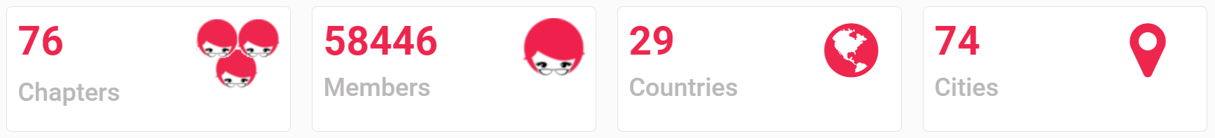

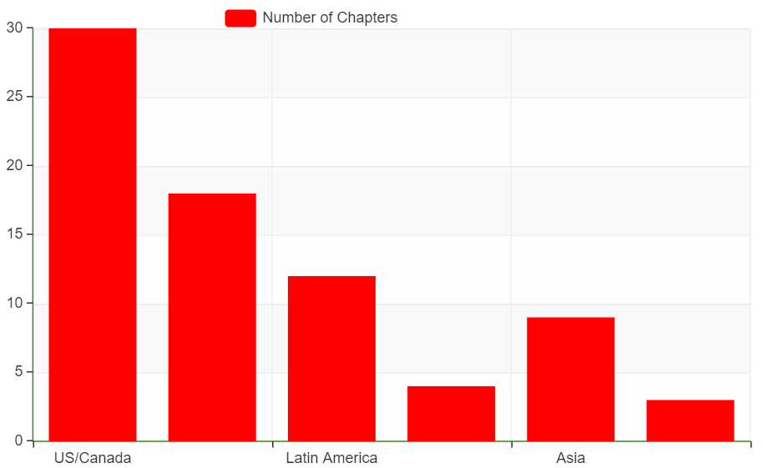
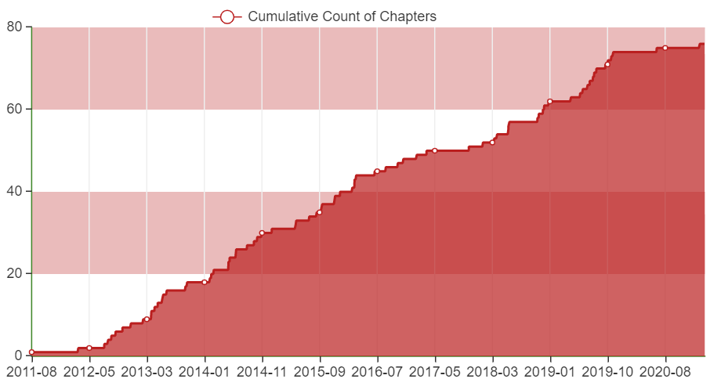
PyLadies Global
PyLadies is an international mentorship group which focuses on helping more women become active participants in the Python open-source community.
https://nyc-pyladies.github.io/pyladies-dashboard/pyladies.html#
Notes:
Meetup Dashboard: this dashboard was created by Ben U to provide a helpful summary of PyLadies Meetup chapters.

Slide 4

Vision and Mission
Vision
Mission
Promote the gender diversity in the Python community
Help more women become active participants and leaders in the Python open-source community.
Goals
Values
Provide a friendly support network for Python enthusiasts worldwide
Help more women become active participants and leaders in the Python open-source community
Organize outreach, education, conferences, events and social gatherings.

Slide 5
Before we start
Recording zoom: We plan to record the workshop today. If you prefer not to be recorded, please turn off your video.
If you have a comment/question: please use the “Raise your hand” feature in Zoom or leave a message in the chat box.

Slide 6

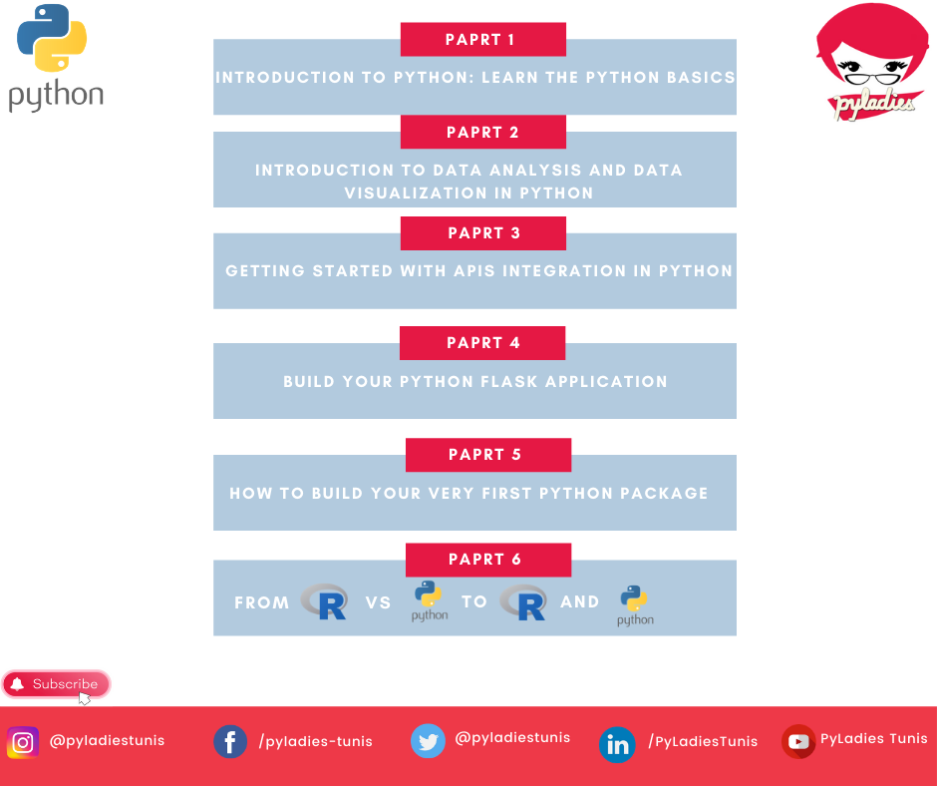
About our next meetups

Slide 7
THANK YOU
tunis@pyladies.com

